Slide 1


JavaScript Basics

Slide 2
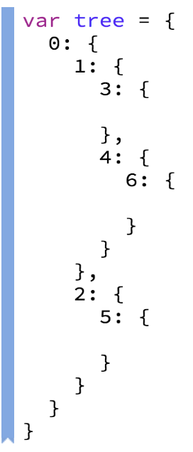
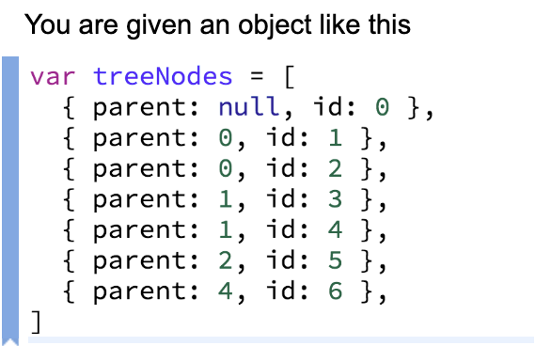
Tasks
Given an object. Invert it (keys become values and values become keys).
If there is more than key for that given value create an array.
2.
Input | Output
{ a: ‘1’, b: ‘2’ } | { 1: ‘a’, 2: ‘b’ }
{ a: ‘1’, b: ‘2’, c: ‘2’ } | { 1: ‘a’, 2: [‘b’, ‘c’] }
{ a: ‘1’, b: ‘2’, c: ‘2’, d: ‘2’ } | { 1: ‘a’, 2: [‘b’, ‘c’, ‘d’] }

Slide 3
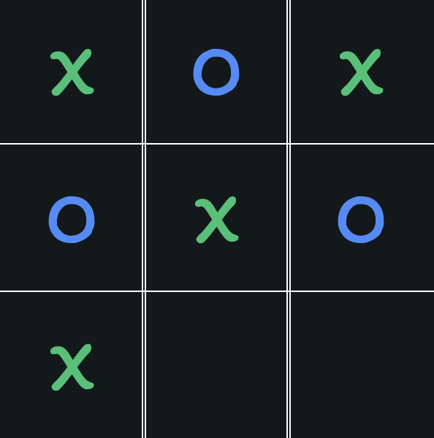
Tic Tac Toe
1. Implement Design For Board
container
tile

Slide 4
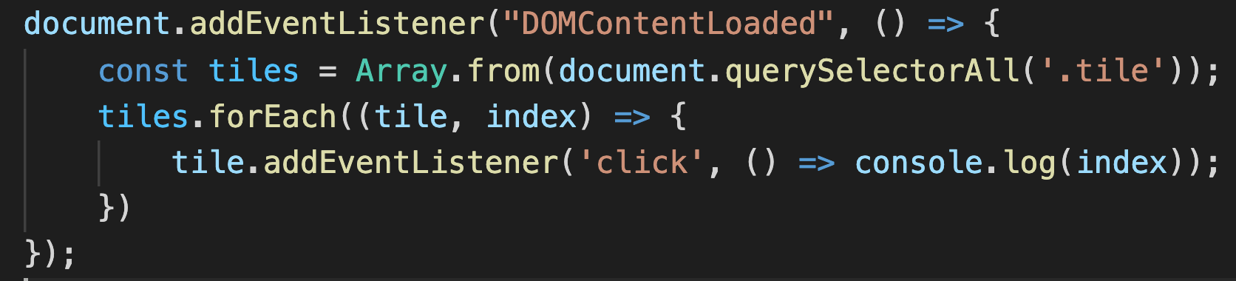
Adding Event Listener

Slide 5
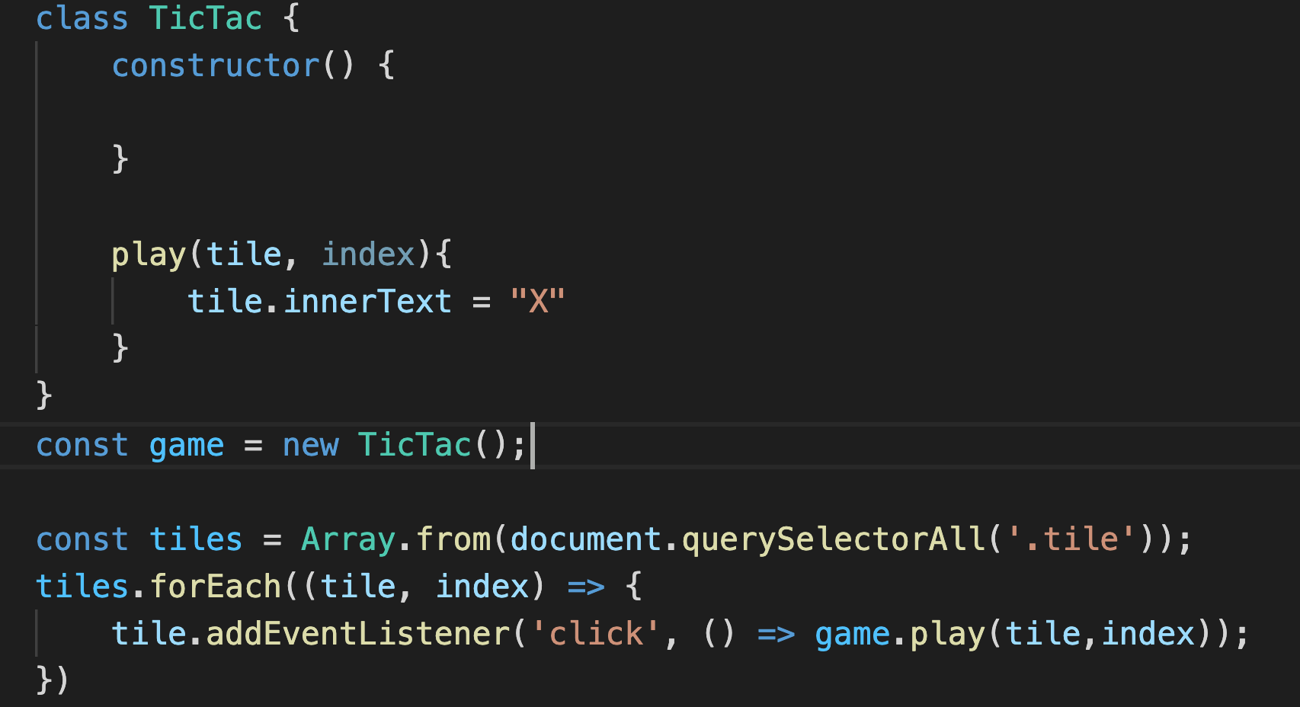
Adding Event Listener

Slide 6
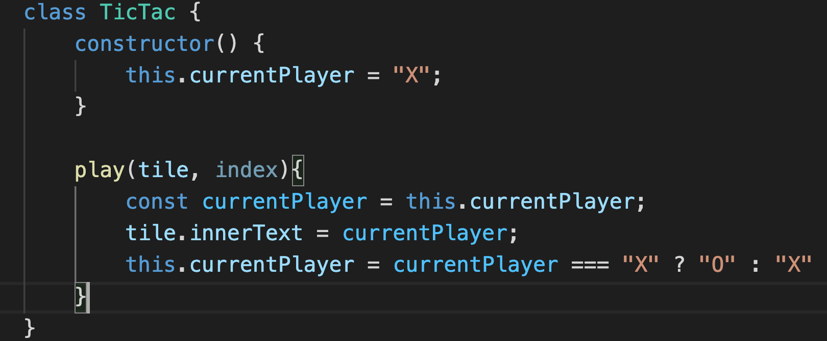
Adding Current Player support

Slide 7
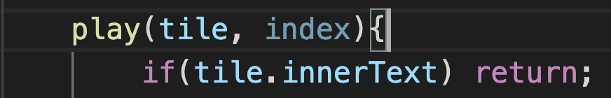
Adding Current Player support
Validate

Slide 8
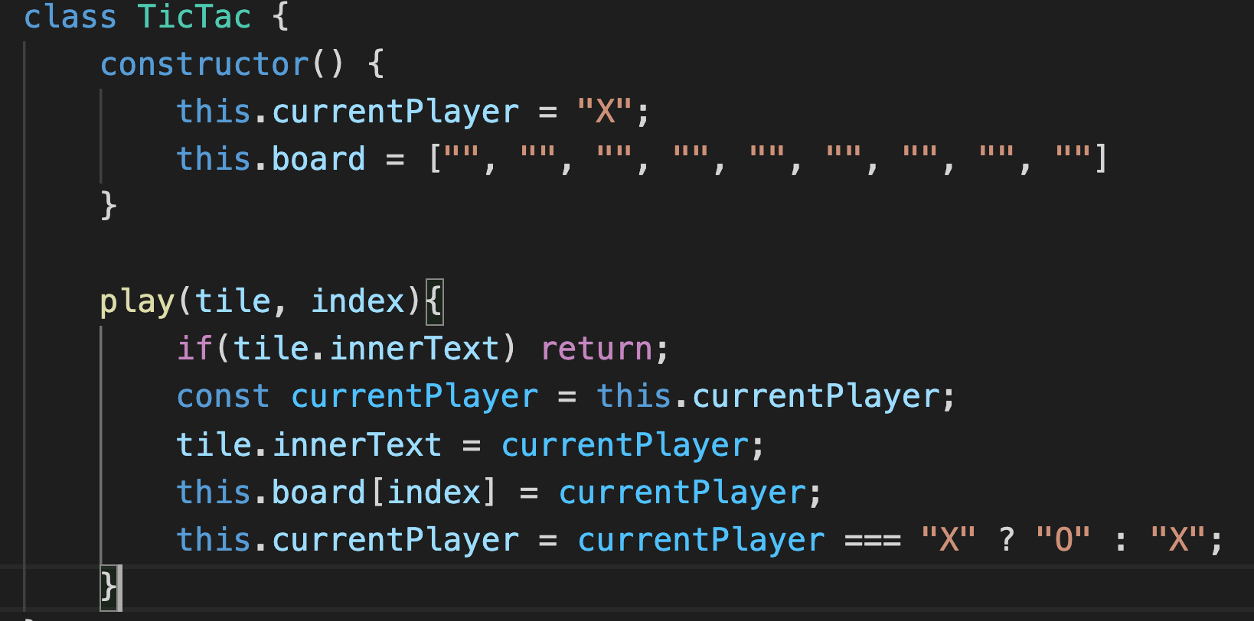
The Game Logic
[“X”, “O”, “O”
”O”, ”X”, “”
“”, “”, “” ]
We will use array to keep values

Slide 9
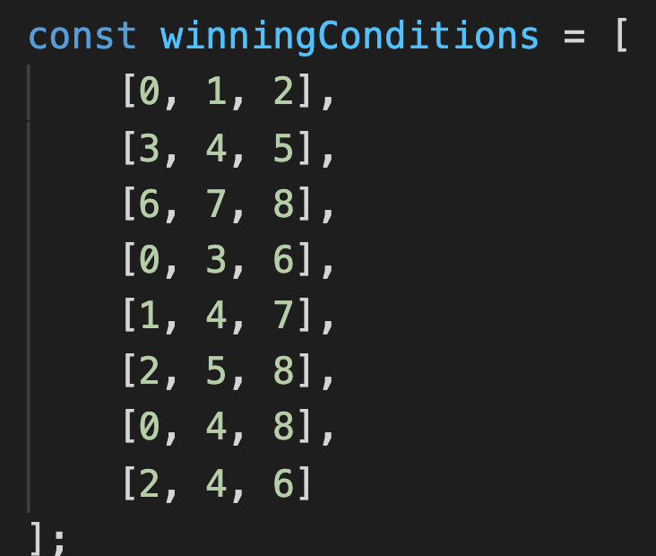
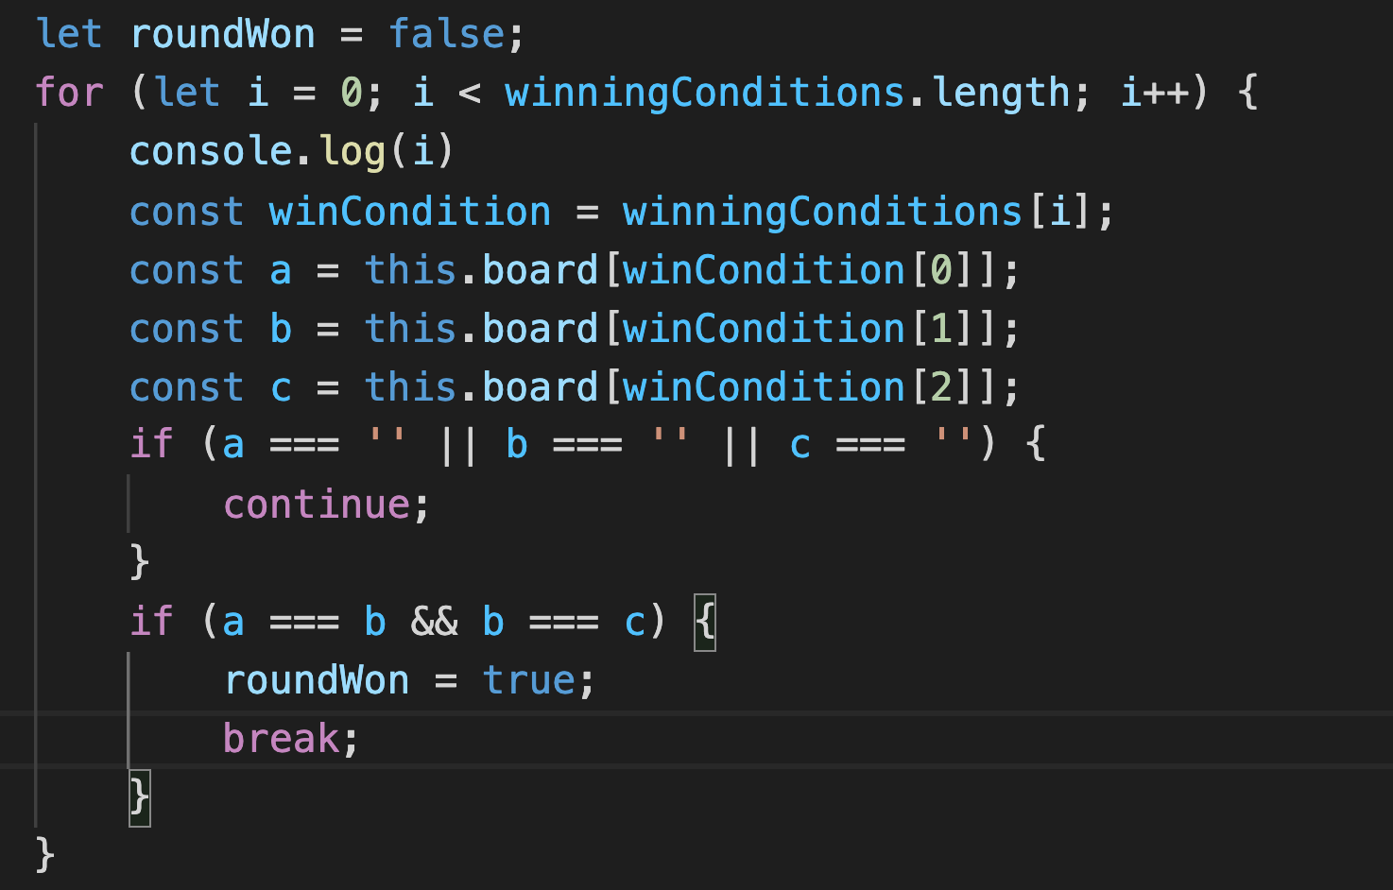
Winning Condition

Slide 10
Winning Condition

Slide 11
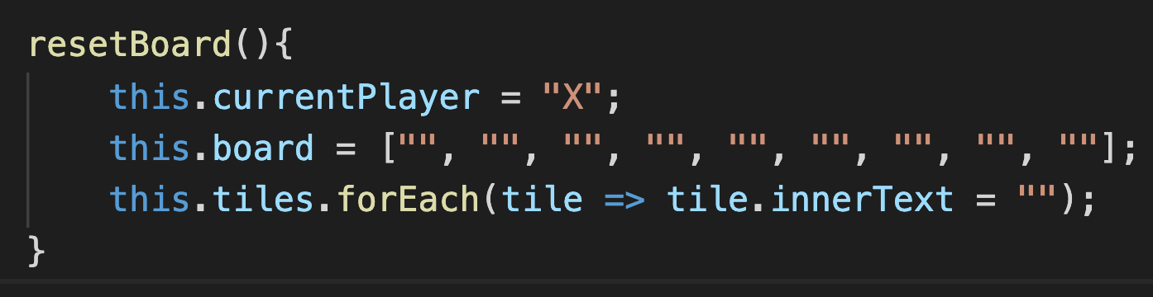
Reset Board

Slide 12
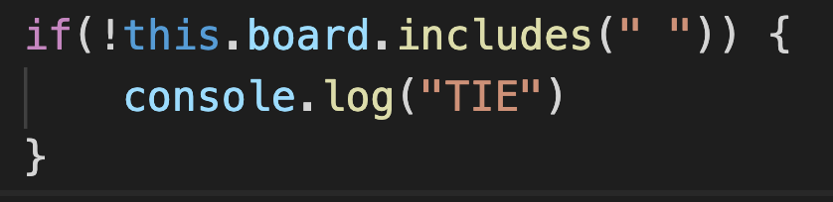
Tie
on validateGameResult() function

Slide 13
Tasks
Show Reset button which will reset the Game
Show info part which will include game info (Who’m turn is ?, Who is Winner?)
Show Game Score (Also add Inputs for entering user names)

